Slide 1
Object Oriented Programming: Part 1: Classes and Objects
By: Ryan Alterman
Revised: 10-24-17

Slide 2
What is Object Orientation?
This is the main point of C++
Main way this is achieved
Classes
Referred to as user defined types
Classes
They use:
Data
Methods
Called members

Slide 3
Class Definitions
When you define a class, you create a blueprint
DOES NOT ACTUALLY DEFINE DATA
Just what the class name does and means
This is why objects exist
Used to define what operations can happen to this object of this class
Defined using the keyword Class
Class objects can either be Public or Private or Protected
Public: Objects can be accessed from outside of scope
Private or Protected: Not usable by objects outside of scope

Slide 4
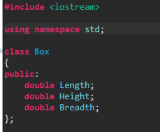
Defining Classes

Slide 5
Defining Objects
Objects are created from classes
Declared using the same format as variables
This gives the object's access to the data members of that class

Slide 6
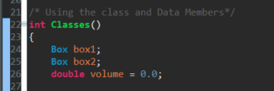
Defining Objects

Slide 7
Accessing Data Members
Public Operators can be used through the accessing operator( . )
You can not use this method for Private or Protected operators

Slide 8
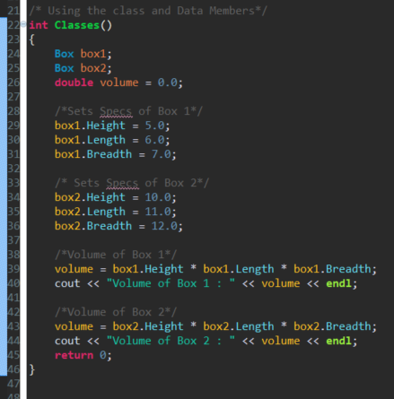
Accessing Members

Slide 9
Classes & Objects in Detail
Class Member Functions
A function that has its definition or prototype within the class definition like variables.
Class Access Modifiers
Keywords that change the scope of an object. Public, Private, or Protected. Default is assumed as Private.
Constructor and Destructor
A special function that is called to create class objects and destroy class objects
Copy Constructor
A constructor that creates an object by initializing it with the same class, which already exists.
Friend Functions
A function that is permitted full access to private and protected members
Inline Functions
Compiler tries to to expand the code in the body in place of function call.

Slide 10
Classes & Objects in Detail(Cont.)
This Pointer
Every object has a special this pointer that points directly to the object in the class.
Pointer to C++ Classes
Done the same way as pointers to structures
Static Members of a Class
Both data members and function members of a class can be declared as static.

Slide 11
Challenge
In the context of Command Based Programming, when would we use classes? Why? Now create a class relevant to the current robot design that we are working on.

Slide 12
Next: Object Oriented Programming: Part 2

